Slide 1
Being an Acolyte

Slide 2
Why do we have acolytes?
Acolytes bring…
celebration
reverence
anticipation
to the service by...
leading!

Slide 3
Before the Service
Check bulletin/newsletter to see when you are signed up.
If you are unable to acolyte, find a replacement & contact church office by phone or email.
Church begins between 8:55 - 9 AM on Sundays.
Check the church website if you are unsure when the service starts (especially for holidays).
Be 10-15 minutes early so you can get ready.
Find a robe in the sacristy.
Get the candle lighter.
For questions, comments, or concerns, contact the acolyte trainer.

Slide 4
Entering
Formal order of entering:
1) assisting minister
2) acolyte
3) pastor

Slide 5
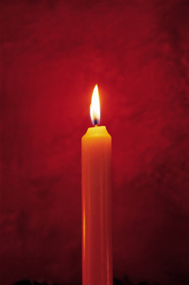
Why do we light candles?
The lighting of candles in worship is symbolic of Jesus coming to be in a worshipping community. Just as the Israelites were guided through the desert by a pillar of fire, we too are led by Christ—the light of the world!

Slide 6
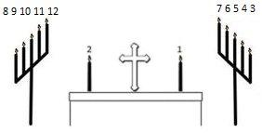
Candles
Lighting candles:
1) Front table candles, right to left
2) Back altar candles (candelabras):
- Right side candles, bottom to top
- Left side candles, bottom to top
3) Christ (Paschal) candle to be lit only for the
following:
- The Baptism of Our Lord Sunday - All Saints Sunday - The Season of Easter | - Easter Sunday - A baptism - A funeral

Slide 7
Offering
Take the offering plates from the ushers and place them on the left side of the altar, itself, behind the altar table.

Slide 8
Continuous Communion
Take the wood tray and follow behind the assisting minister (order: pastor, assisting minister, acolyte) to collect the used communion cups.
When the tray is full (or when the assisting minister switches his/her tray), switch it out.
The assisting minister will move to the other side of the pastor about halfway through communion—just follow his/her lead.
The pastor will give you and the assisting minister communion after the congregation. After that, you can sit back down.

Slide 9
Kneeling Communion
Take the wood tray and follow behind the assisting minister (order: pastor, assisting minister, acolyte) to collect used communion cups.
When the tray is full (or when the assisting minister switches his/her tray), switch it out.
You will be moving back and forth between the two sides—just follow the pastor’s and assisting minister’s lead.
The pastor will give you and the assisting minister communion after the congregation. After that, you can sit back down.

Slide 10
Service End
After the pastor and the assisting minister walk out, you need to extinguish all of the candles with the candle snuffer, being careful not to push too far down on the candle (this pushes the wick into the wax).
Once you finish extinguishing the candles, go to the sacristy and hang up the robe (neatly) and candle lighter where you found them.

Slide 11
Any questions?

Slide 12
Close this presentation and navigate
to the review section of the acolyte website.
Time to review!

